Slide 1
Prophet

Slide 2



Seasonality (Smoothing) Parameter
$$σ$$
the strength of the seasonality component
Holiday (Smoothing) Parameter
$$v$$
seasonality 와 holiday 자동 탐지 할 수 있나 ... ?
change point 자동 탐지 할 수 있나 ... ?
??
$$τ$$
adjust trend flexibility

Slide 3

Decomposable time series model (Harvey & Peters, 1990)
Time series data
(at time t)
trend
periodic changes
holiday effect
error ~ N
Multiplicative seasonality, where the seasonal effect is a factor that
multiplies g(t), can be accomplished through a log transform
(정확히 식이 어떻게 되지 ...?)

Slide 4
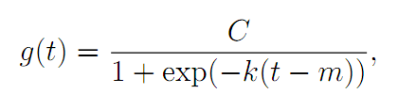
Decomposable time series model (Harvey & Peters, 1990)
Time series data
(at time t)
trend
periodic changes
holiday effect
error ~ N
Nonlinear, Saturating Growth
carrying capacity
logistic
growth
model
(Basic form)
i.e. the number of people that have access to the internet
growth rate
offset parameter

Slide 5
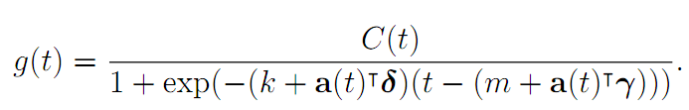
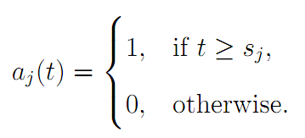
Decomposable time series model (Harvey & Peters, 1990)
Time series data
(at time t)
trend
periodic changes
holiday effect
error ~ N
Nonlinear, Saturating Growth
[Time varying] carrying capacity
i.e. the number of people that have access to the internet
Piecewise
logistic
growth
model
growth rate
offset parameter
add delta of growth rate
after change point

Slide 6


Decomposable time series model (Harvey & Peters, 1990)
Time series data
(at time t)
trend
periodic changes
holiday effect
error ~ N
Linear Trend
Piecewise
logistic
growth
model
growth rate
offset parameter
add delta of growth rate
after change point
tau is estimated variance of data ... ?
왜 laplace 분포를 쓰는지,
왜 분포를 쓰는지 이해 안됨

Slide 7
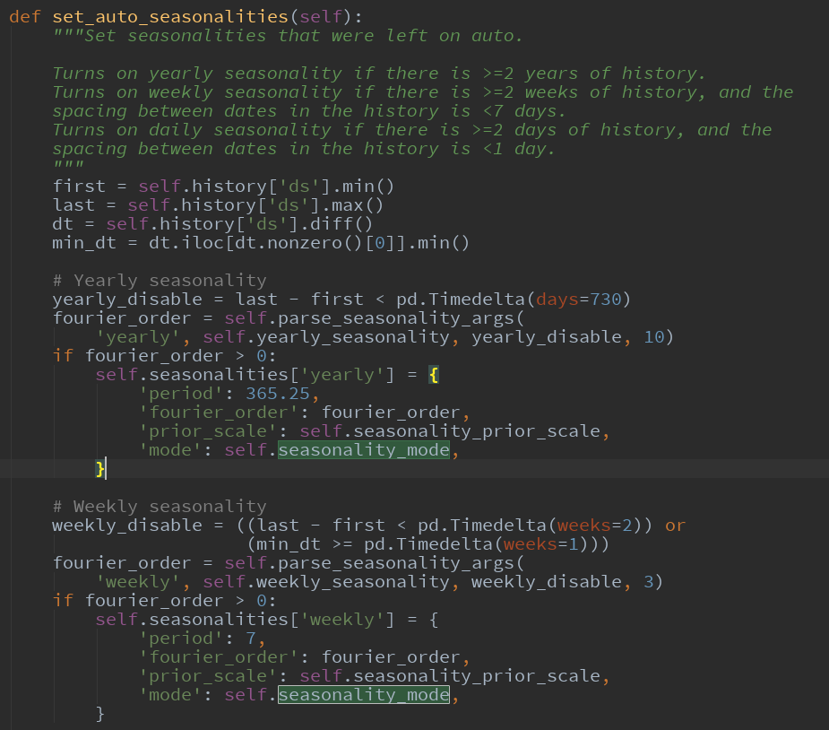
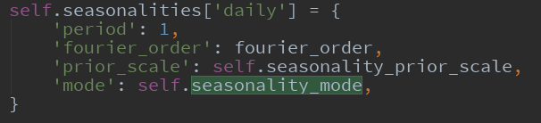
기본 날짜 setting 이
day 로 가정되어 있음 ... !

